Slide 1

GitHub User Analysis
Xin Guan | Ziqian Ge

Slide 2
About GitHub
a web-based hosting service of version control using Git. (Wikipedia)
The world's largest community of developers to discover.
31 million users (October 2018)
100 million repositories (November 2018)
Notes:
According to Evans Data Corporation(EDC) there are about 23 million developers worldwide. So we believe Github is a good representation of United States even world developers.
https://www.c-sharpcorner.com/article/how-many-software-developers-are-there-in-the-world/

Slide 3
Goal of Project
Who are those developers
Trends among developers

Slide 4
Content of the Project
Data Collection
Data Cleaning
User Analysis
Repository Analysis
Prediction

Slide 5
Data Collection
GitHub API
Third party data from GHTorrent

Slide 6
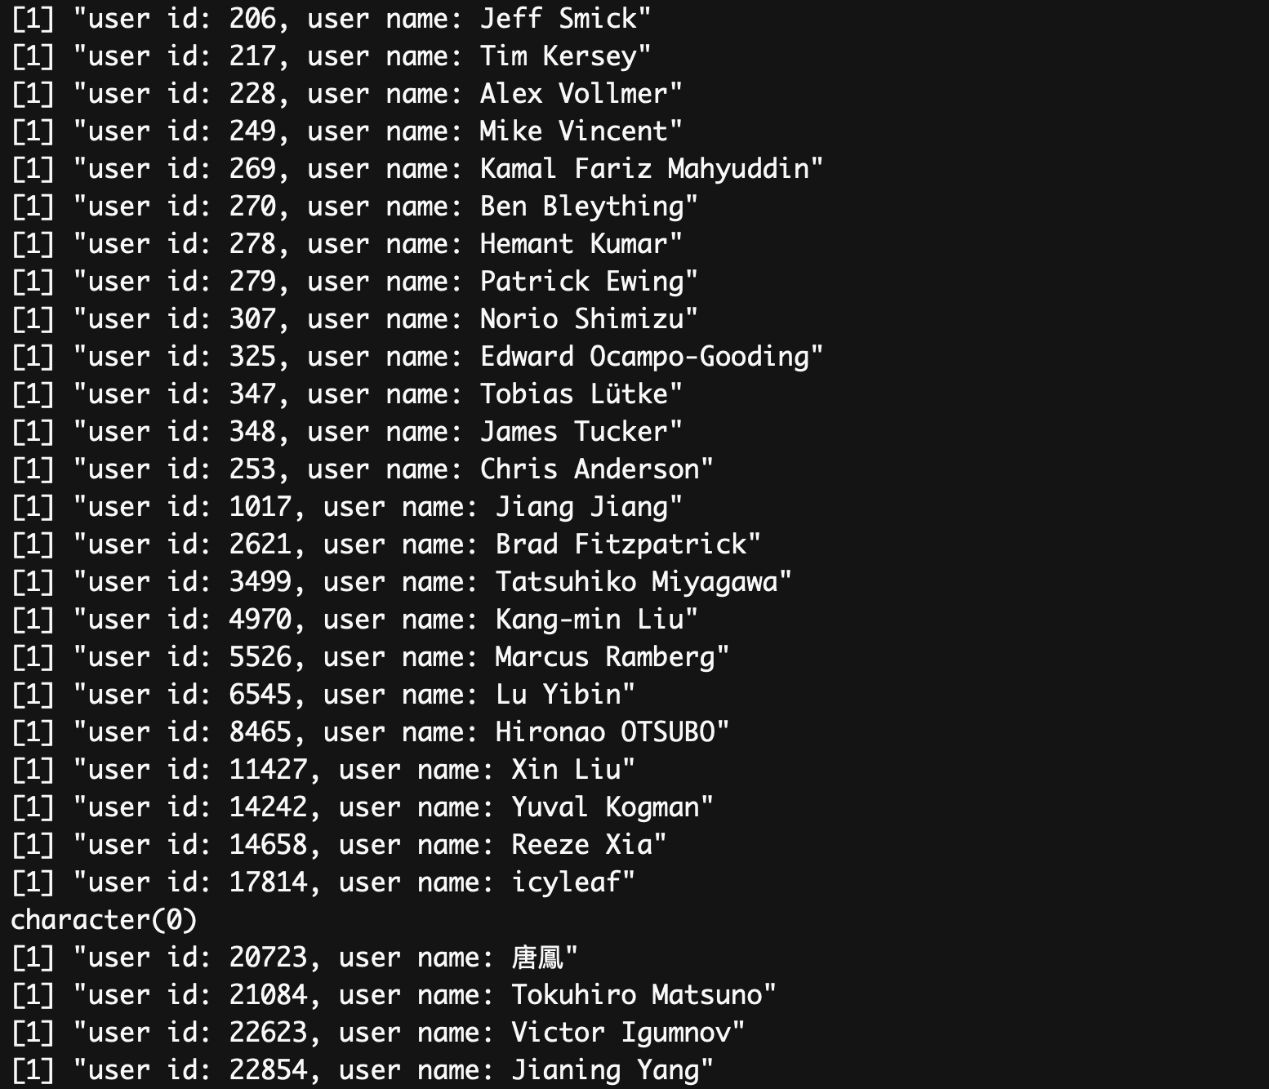

Slide 7
Difficulty
Large amount of data
restricted access to API (5000 per hour)
Not in the form of relational data base
Uncleaned Data

Slide 8
Data Cleaning
Ignore users with 0 repositories, 0 followers and 0 following
Ignore users without self-description (no location, company or bio)
Ignore repos with 0 stars, 0 forks, 0 open issues, or 0 subscibers
Remove NA
Outliers

Slide 9
User Analysis
Where?
Selecting Users with location data
Clean users’ information with Regex
Count, Sort, Plot

Slide 10
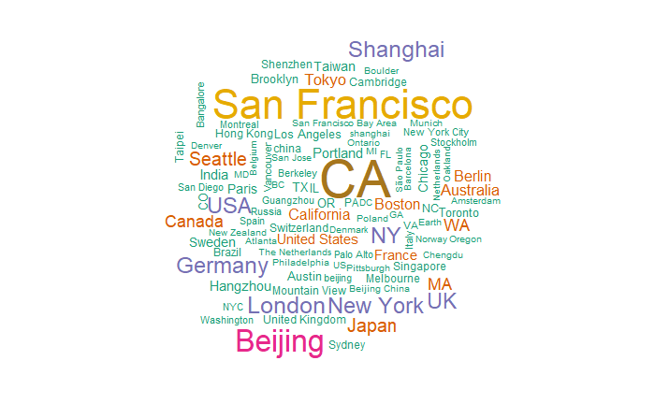

Slide 11
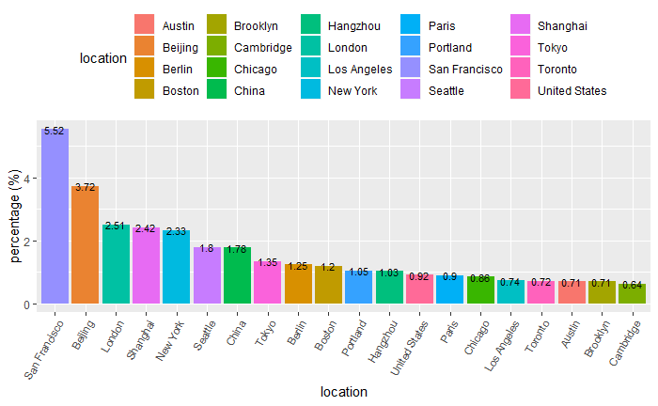

Slide 12
User Analysis
Who?
Extract users with introduction
Delete meaningless words
Count the frequency of words
Sort and Plot

Slide 13
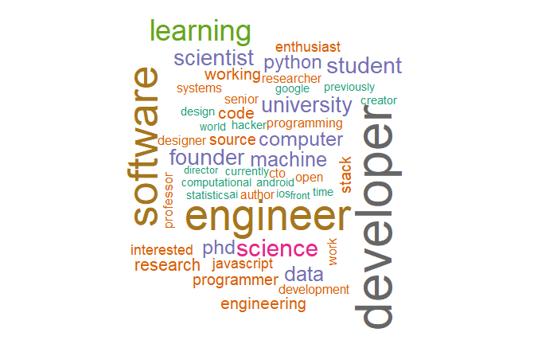

Slide 15
User Analysis
Followers and Following
Clean Up data – NA / 0 cases
Outliers
Plot

Slide 17
User Analysis
Not Finished Task:
Identify their company / institution / job
Relate users with their repositories

Slide 18
Repo Analysis
Languages
1. Count repos that has changed in a day by language
2. Compare popular language with history
3. Explore languages of popular repos

Slide 19


Slide 20
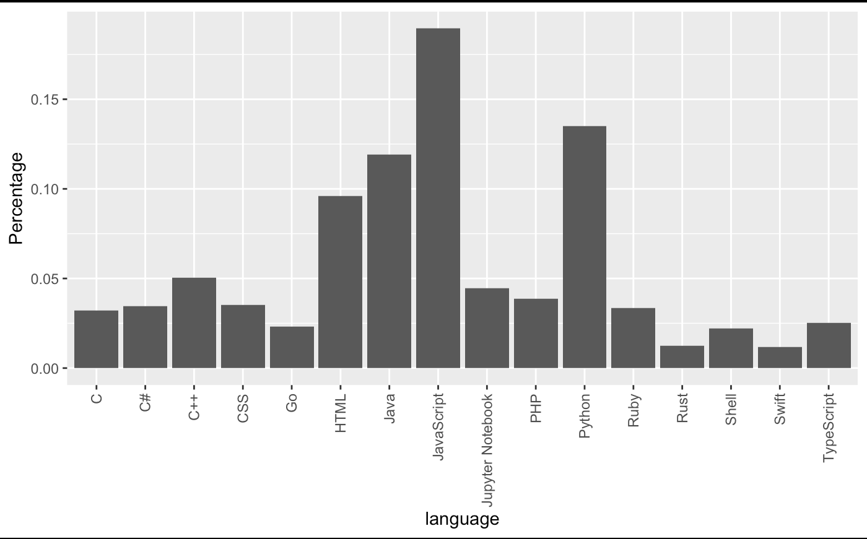
Notes:
2019-04-06

Slide 21
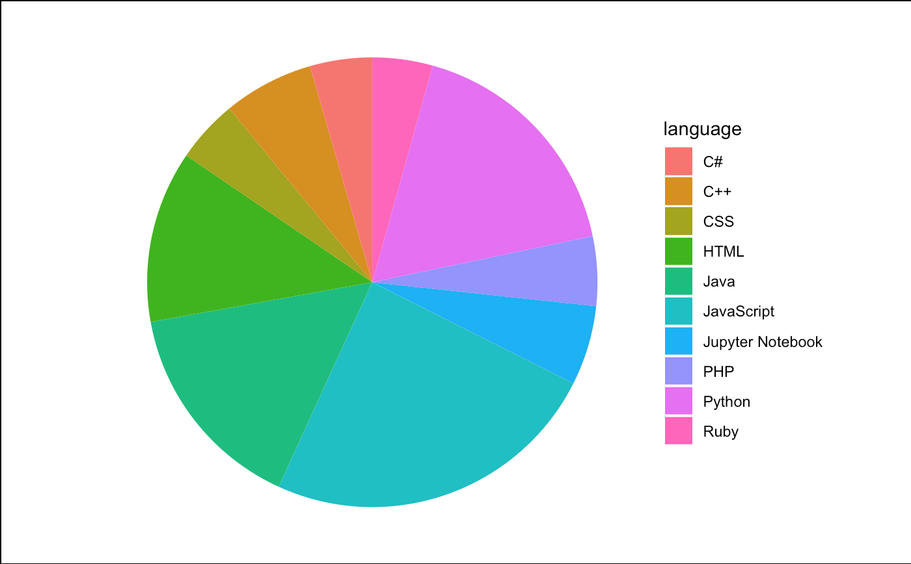
Notes:
2019-04-06

Slide 22
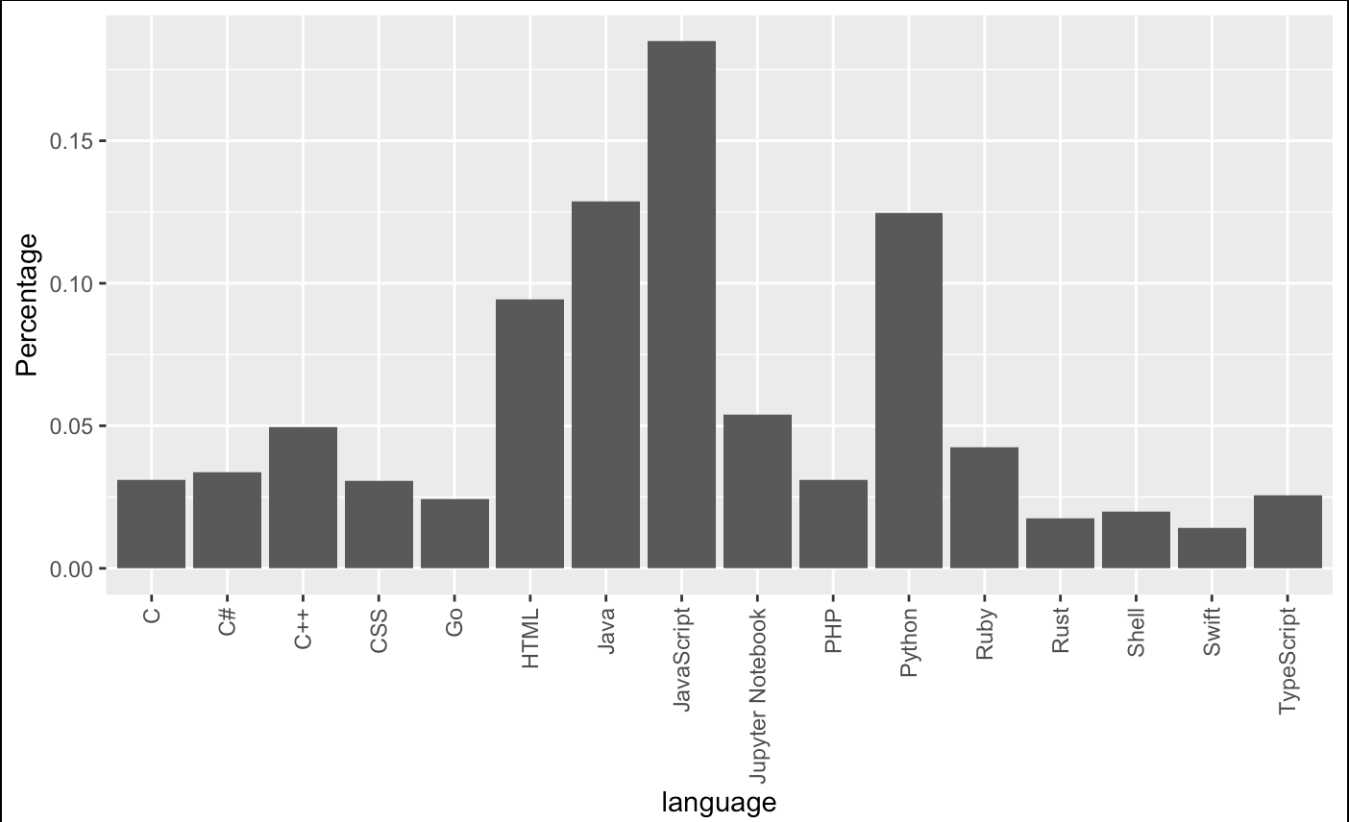
Notes:
2019-04-01

Slide 23
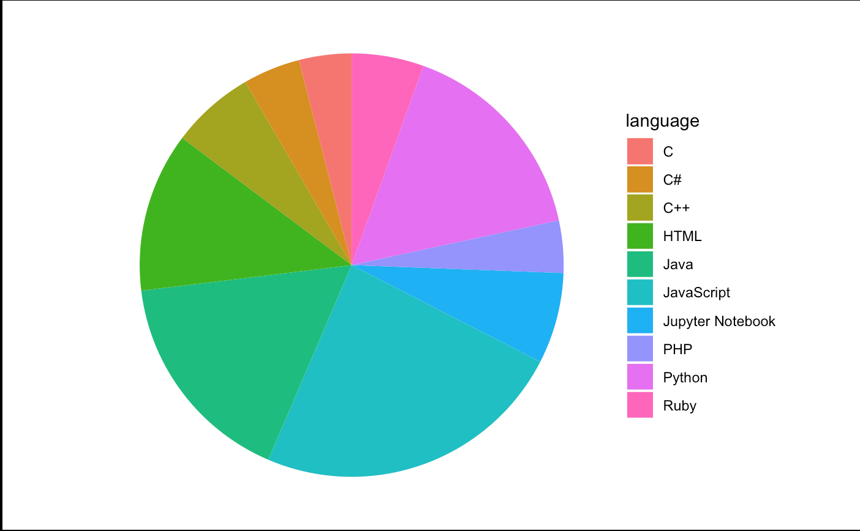
Notes:
2019-04-01

Slide 24
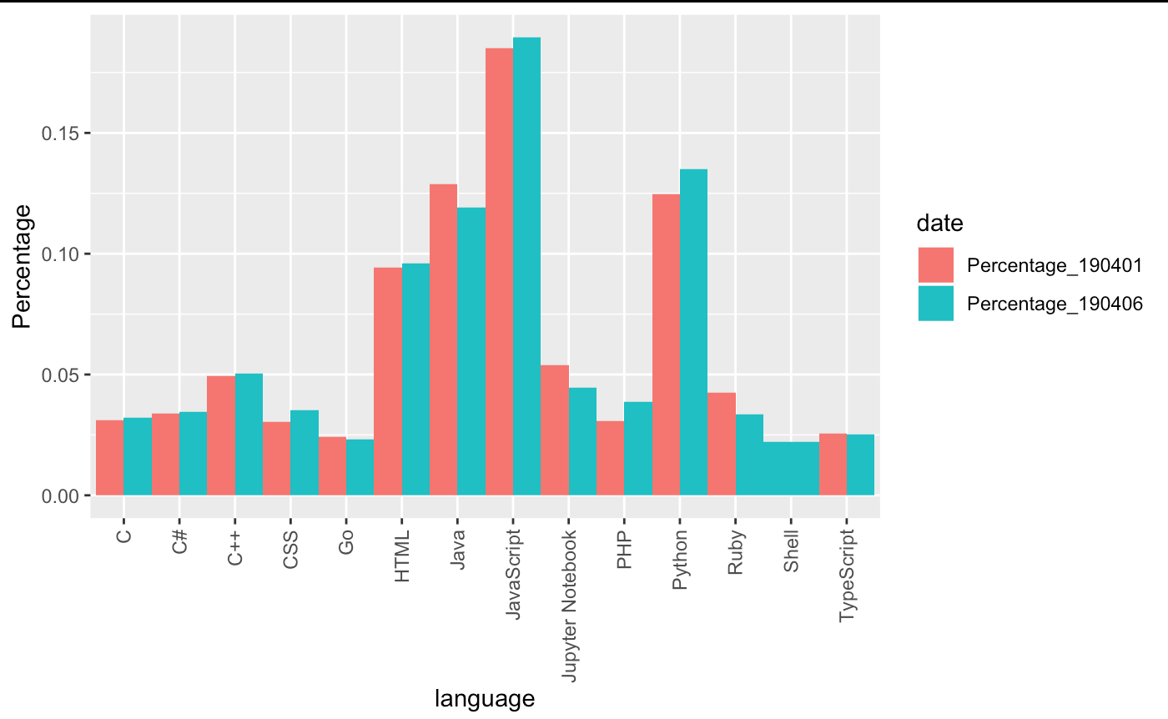

Slide 25
Repo Analysis
To be finished
Relate with users, i.e. repo owner and contributors
Relate with commits

Slide 26
Prediction
Based on properties of the owner of a repository, and his/her other repositories, predict the popularity of the repo.
Evaluate the popularity by a popularity index
Build a model on properties of a user
Predict using regression

